Slide 1
Course : 0553T / Multimedia System
Year : 2015
MAKING MULTIMEDIA
Session 08

Slide 2
OUTLINE
The Stages of a Multimedia Project
The Intangibles
Multimedia Skills
Hardware
Software
Authoring Tools

Slide 3
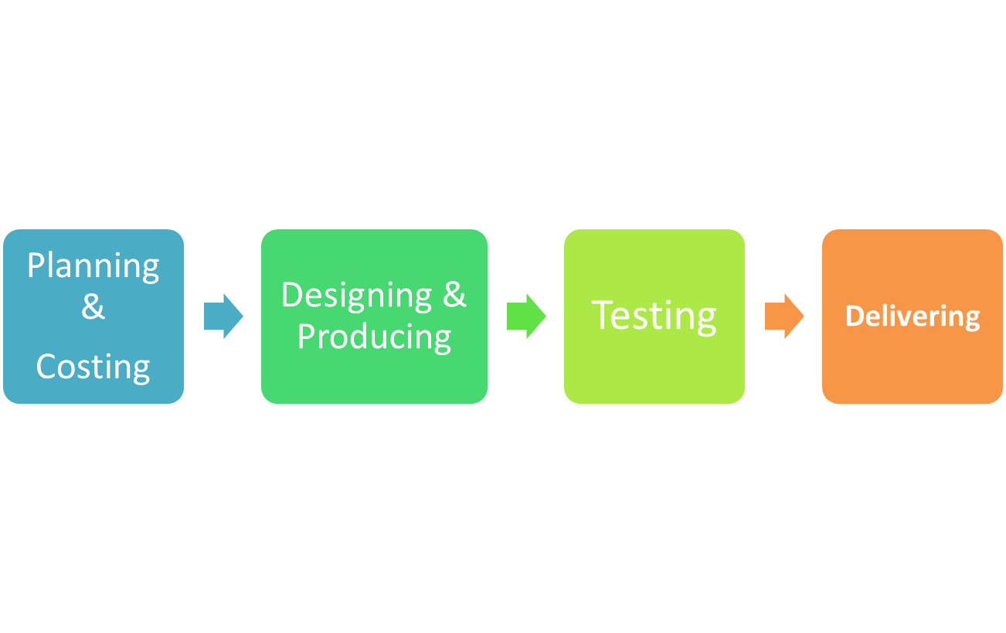
The Stages of a
Multimedia Project
The four basic stages in a multimedia project :

Slide 4
The Stages of a
Multimedia Project
Planning & Costing
  Begin with an idea or a need
  Plan out the writing skills, graphic art, music, video, and other multimedia that required.
  Estimate the time
  Prepare the budget
  Work up a short prototype

Slide 5
The Stages of a
Multimedia Project
Designing and Producing
  Perform each of the planned task to create a finished product
  Feedback cycles with a client
Testing
  Test the programs to make sure that the programs meet the objectives of the project, work properly, and meet the needs of client.
Delivering
  Package and deliver the project to the end user

Slide 6
The Intagibles
The intangibles elements needed to make good multimedia :
  Creativity
    Develop a sense of its scope and content of the multimedia project
  Organization
    Develop an organized outline and plan that rationally details the skills, time, budget ,tools, and resources that needed by the project
  Communication Skill
    Communication among workgroup members and with the client is essential to the efficient and accurate completion of project

Slide 7
Multimedia Skills
To produce good multimedia, need a similar diverse range of skills ( knowledge of computers, text, graphics arts, sound, and video)
Adapt the team roles from a mix of motion picture industry, radio and television broadcasting, and computer software experiences.

Slide 8
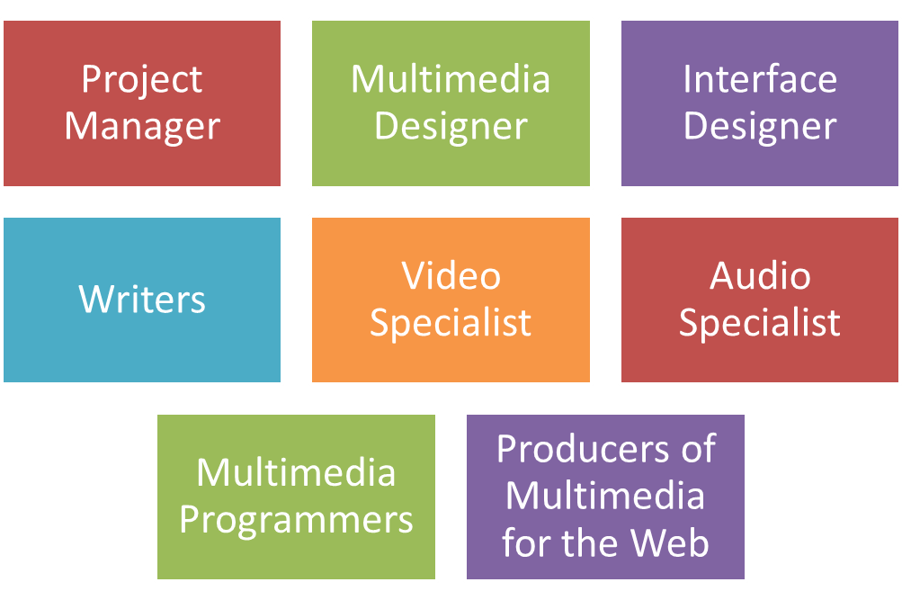
Multimedia Skills
Multimedia Teams :

Slide 9


Hardware
The two most significant platforms for producing and delivering multimedia projects :

Slide 10
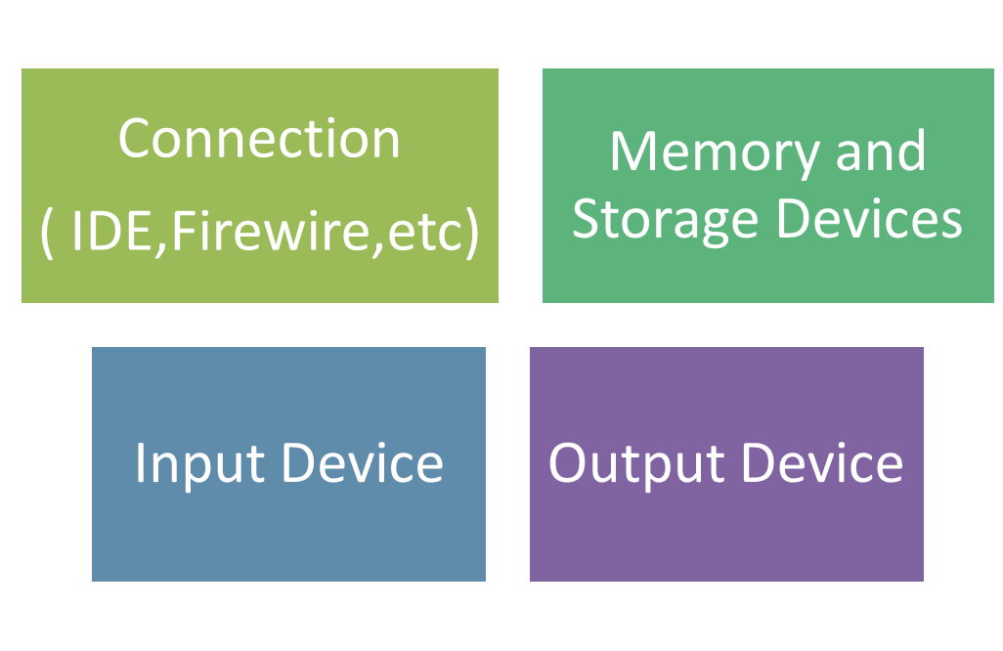
Hardware
The equipment required for developing multimedia project depend on the content of the project as well as its design.

Slide 11
Software
The software for building multimedia project :
  Text Editing and Word Processing Tools
  OCR Software
  Painting and Drawing Tools
  3D Modelling and Animation Tools
  Image-Editing Tools
  Sound-Editing Tools
  Animation, Video and Digital Movie Tools

Slide 12
Authoring Tools
Authoring tools used for :
  designing interactivity and the user interface
  Presenting project on screen
  Assembling diverse multimedia elements into a single cohesive product

Slide 13
Authoring Tools
Authoring software provide :
  an integrated environment for binding together the content and functions of project
  Everything need to create, edit, import specific types of data
  Assembled raw data into a playback sequence or cue sheet
  A structured method or language for responding to user input

Slide 14
Authoring Tools
With multimedia authoring software can make :
  Video production
  Animation
  Games
  Interactive web sites
  Demo disks and guided tours
  Presentation
  Kiosk Application
  Interactive Training
  Simulation, Prototype, and technical presentations

Slide 15
Authoring Tools
Type of Authoring Tools for e-learning :
  Adobe Captivate
  Adobe Presenter
  Articulate StoryLine and Studio
  Composica
  EasyGenerator
  GoAnimate
  Etc
Online Authoring tools
  ITyStudio, CourseArc (e-learning)
  Animoto, WeVideo, Magisto (video)
  Soundation, SoundSaunna, Twisted Wave(Audio)
  etc.

Slide 16
Authoring Tools
Type of Authoring Tools :
  Card or Page Based Authoring Tools
    Example : LiveCode
  Icon-Object Based Authoring Tools
    Multimedia elements and interaction cues (events) are organized as objects in a structural framework or process.

Slide 17
Authoring Tools
Type of Authoring Tools (Continue) :
  Time-Based Authoring Tools :
    Authoring systems wherein element and events are organized along a timeline, with resolutions as high as or higher than 1/30 second.
    Example : Adobe Flash , Adobe Director.

Slide 18
Authoring Tools
When choosing Authoring Tools consider :
  Editing Features
    For creating , editing, and converting element of multimedia
  Organizing Features
    Provide organization, design and production process for multimedia involves storyboarding and flowcharting

Slide 19
Authoring Tools
When choosing Authoring Tools consider (con’t) :
  Programming Features
    Visual programming,
    Programming with scripting,
    Traditional Language such as C
    Document Development Tools

Slide 20
Authoring Tools
When choosing Authoring Tools consider (con’t) :
  Interactivity Features
    Provide one or more interactivity :
      Simple branching
      Conditional branching
      Structure language that support complex programming

Slide 21
Authoring Tools
When choosing Authoring Tools consider (con’t) :
  Performance Tuning Features
  Playback Features
  Delivery Features
  Cross Platform Features
  Internet Playability

Slide 22
Supporting
Materials
http://www.adobe.com/products/director/
http://www.adobe.com/products/flash/whatisflash/

Slide 23
Exercise
Discuss the intangible elements needed to make good multimedia !
Explain the four primary stages in a multimedia project !

